Slide 1
MATLAB OOP Numerical Methods Application
Developed using Classes, Inheritance, Encapsulation, Polymorphism, and Abstraction

Slide 2
PRESENTED BY GROUP ELEVEN MEMBERS.
NAME | REGISTRATION NUMBER | PROGRAM OF STUDY | SIGNATURE
MUKYALA ROSE MIIRIAM | BU/UP/2024/1041 | WAR
OGWANG EMMANUEL | BU/UP/2024/3254 | WAR
NSAMBA SHAFFIC | BU/UP/2024/5346 | MEB
KAGODA ENOCK | BU/UP/2023/1097 | WAR
BUSUULWA HASSAN | BU/UP/2024/3732 | AMI
WAMBI KENNETH | BU/UP/2023/0950 | PTI
ATWIINE SANDRAH | BU/UG/2024/2632 | MEB
ABESIGA KEITH ADAMS | BU/UP/2024/3974 | AMI
WASSWA FRANCIS | BU/UG/2024/2669 | APE
NANDERA JULIET | BU/UP/2024/1047 | WAR

Slide 3
Objective of the Project
• To develop a modular MATLAB application using Object-Oriented Programming (OOP).
• Implement numerical methods for solving computational problems.
• Use a parent abstract class (NumericalSolver) and two subclasses:
– DifferentialSolver for differential equations
– IntegralSolver for integration problems
• Execute all methods and plots from a Live Script (main_script.mlx).

Slide 4
Folder and File Structure
Project Folder:
📁 NumericalMethodsProject
┣ 📄 NumericalSolver.m (Abstract Parent Class)
┣ 📄 DifferentialSolver.m (Subclass for ODEs)
┣ 📄 IntegralSolver.m (Subclass for Integration)
┗ 📄 main_script.mlx (Live Script that runs everything)
All files must be in the same directory or added to MATLAB path.

Slide 5
Parent Class: NumericalSolver
• Abstract class providing the base structure for all solvers.
• Implements encapsulation (private computationTime) and abstraction (abstract methods).

Slide 6
NUMERICAL SOLVER
% ABSTRACT PARENT CLASS
classdef (Abstract) NumericalSolver
properties (Access = protected)
options
end
properties (Access = private)
computationTime
end
methods (Abstract)
result = solve(obj)
plotResult(obj)
end
methods
function setComputationTime(obj, t)
obj.computationTime = t;
end
function t = getComputationTime(obj)
t = obj.computationTime;
end
end
end

Slide 7
Subclass 1: DifferentialSolver
• Inherits from NumericalSolver.
• Implements Euler and Runge-Kutta methods for solving ODEs.
• Demonstrates polymorphism by redefining abstract methods.
Key code:
switch lower(obj.method)
case 'euler'
y(i+1) = y(i) + h * f(t(i), y(i));
case 'runge-kutta'
... (RK4 implementation)
The codes are shown below

Slide 8
classdef DifferentialSolver < NumericalSolver
properties
func
tspan
y0
h
method
end
methods
function obj = DifferentialSolver(func, tspan, y0, h, method)
obj.func = func;
obj.tspan = tspan;
obj.y0 = y0;
obj.h = h;
obj.method = method;
end
function result = solve(obj)
tic;
t = obj.tspan(1):obj.h:obj.tspan(2);
n = length(t);
y = zeros(1, n);
y(1) = obj.y0;

Slide 9
Subclass 2: IntegralSolver
• Inherits from NumericalSolver.
• Implements Trapezoidal and Simpson's methods.
• Uses dynamic computation of integral values and time measurement.
Key code:
switch lower(obj.method)
case 'trapezoidal'
I = h/2 * (y(1) + 2*sum(y(2:end-1)) + y(end));
case 'simpson'
I = h/3 * (y(1) + 4*sum(y(2:2:end-1)) + y(end));
Integral solver codes

Slide 10
eclassdef IntegralSolver < NumericalSolver
properties
func
a
b
n
method
end
methods
function obj = IntegralSolver(func, a, b, n, method)
obj.func = func;
obj.a = a;
obj.b = b;
obj.n = n;
obj.method = method;
end
function result = solve(obj)
tic;
h = (obj.b - obj.a)/obj.n;
x = obj.a:h:obj.b;
y = obj.func(x);
switch lower(obj.method)
case 'trapezoidal'
I = h/2 * (y(1) + 2*sum(y(2:end-1)) + y(end));
case 'simpson'
if mod(obj.n,2)~=0
error('Simpson method requires even n.');
end
I = h/3 * (y(1) + 4*sum(y(2:2:end-1)) + 2*sum(y(3:2:end-2)) + y(end));

Slide 11
otherwise
error('Unknown method.');
end
obj.setComputationTime(toc);
result.I = I;
result.x = x;
result.y = y;
end
function plotResult(obj)
result = obj.solve();
figure;
plot(result.x, result.y, 'LineWidth', 1.5);
title(['Integral Solver using ', obj.method]);
xlabel('x');
ylabel('f(x)');
grid on;
end
end
end

Slide 12
Live Script: main_script.mlx
• The Live Script acts as the controller that runs both subclasses.
• It creates objects from DifferentialSolver and IntegralSolver.
• Executes and compares computation times with plots.
Example:
solver1 = DifferentialSolver(f, [0 5], 1, 0.1, 'Euler');
solver1.plotResult();
intSolver2 = IntegralSolver(f2, 0, pi, 100, 'Simpson');
intSolver2.plotResult();
Main script codes

Slide 13
%% Differential Equation Example
f = @(t, y) -2*y + 2 - exp(-4*t);
solver1 = DifferentialSolver(f, [0 5], 1, 0.1, 'Euler');
solver1.plotResult();
fprintf('Euler Computation Time: %.6f seconds\n', solver1.getComputationTime());
solver2 = DifferentialSolver(f, [0 5], 1, 0.1, 'Runge-Kutta');
solver2.plotResult();
fprintf('Runge-Kutta Computation Time: %.6f seconds\n', solver2.getComputationTime());
%% Integral Example
f2 = @(x) sin(x).^2;
intSolver1 = IntegralSolver(f2, 0, pi, 100, 'Trapezoidal');
intSolver1.plotResult();
fprintf('Trapezoidal Result: %.6f, Time: %.6f\n', intSolver1.solve().I, intSolver1.getComputationTime());
intSolver2 = IntegralSolver(f2, 0, pi, 100, 'Simpson');
intSolver2.plotResult();
fprintf('Simpson Result: %.6f, Time: %.6f\n', intSolver2.solve().I, intSolver2.getComputationTime());

Slide 14
Example Plots and Outputs
• Differential equation solutions (Euler vs Runge-Kutta).
• Integration results (Trapezoidal vs Simpson).
• Bar and line plots comparing computation times.
Graphs generated:
– y(t) vs t (for ODEs)
– f(x) vs x (for integrals)
– Bar graph comparing method speeds.
Graphs are shown in the following slides

Slide 15
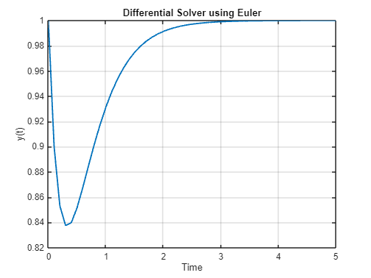

Slide 16
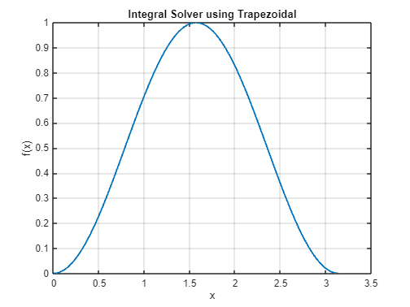

Slide 17
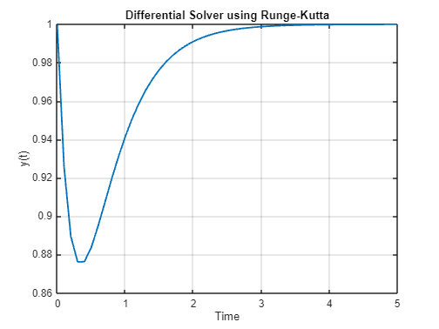

Slide 18
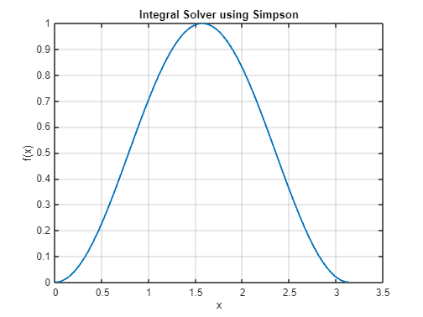

Slide 19
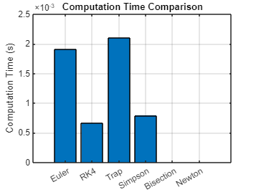

Slide 20
Summary and Insights
• The use of MATLAB OOP allows modular and scalable numerical method design.
• Abstract classes improve reusability and maintainability.
• Encapsulation and polymorphism enhance security and flexibility.
• The Live Script demonstrates the integration of back-end classes in a user-friendly interface.

